Slide 1
Getting started with Github
A guide for CONNECT study investigators and other non-developers.
Daniel E. Russ, Ph.D.
Data Science Research Group,
Division of Cancer Epidemiology and Genetics, NCI

Slide 2

Github is a Web-Based Repository (GIT)
Document 1
The reign in Spain stays mainly on the plains.
Document 2
The unexamined life is not worth living
Version | Documents
2b73114 | Document 1 Document 2
Version | Documents
781efc8 | Document 1 Document 2
2b73114 | Document 1 Document 2
Document 1
The rain in Spain stays mainly on the plains.
Document 2
The unexamined life is not worth living

Slide 3
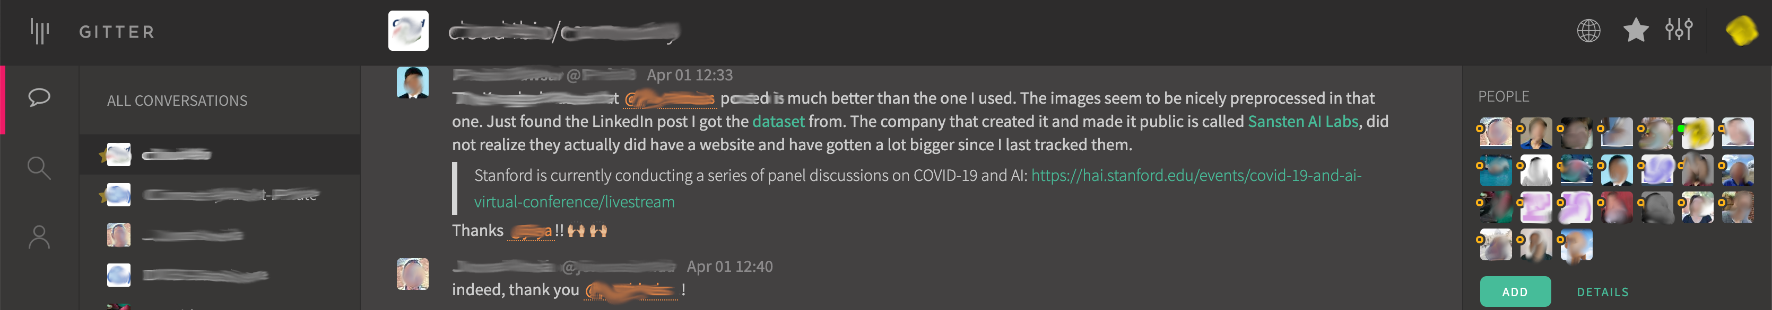
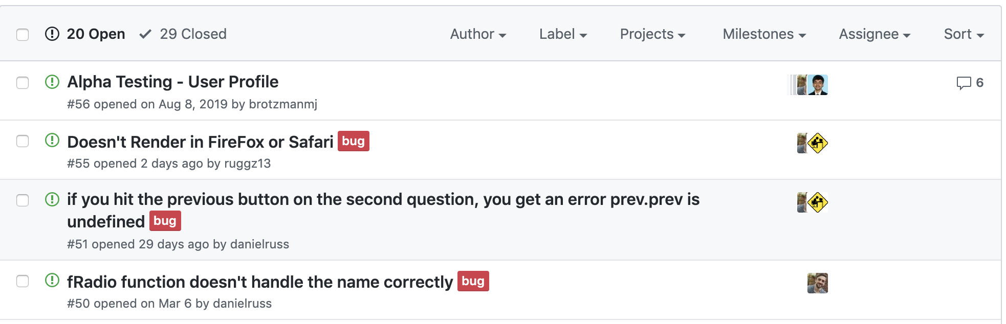
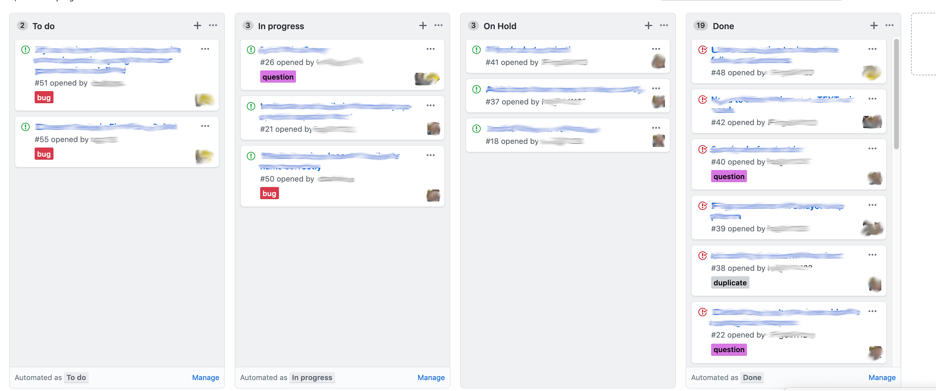
Github integrates communication with our repository
Gitter
Issues
Kanban Boards

Slide 4
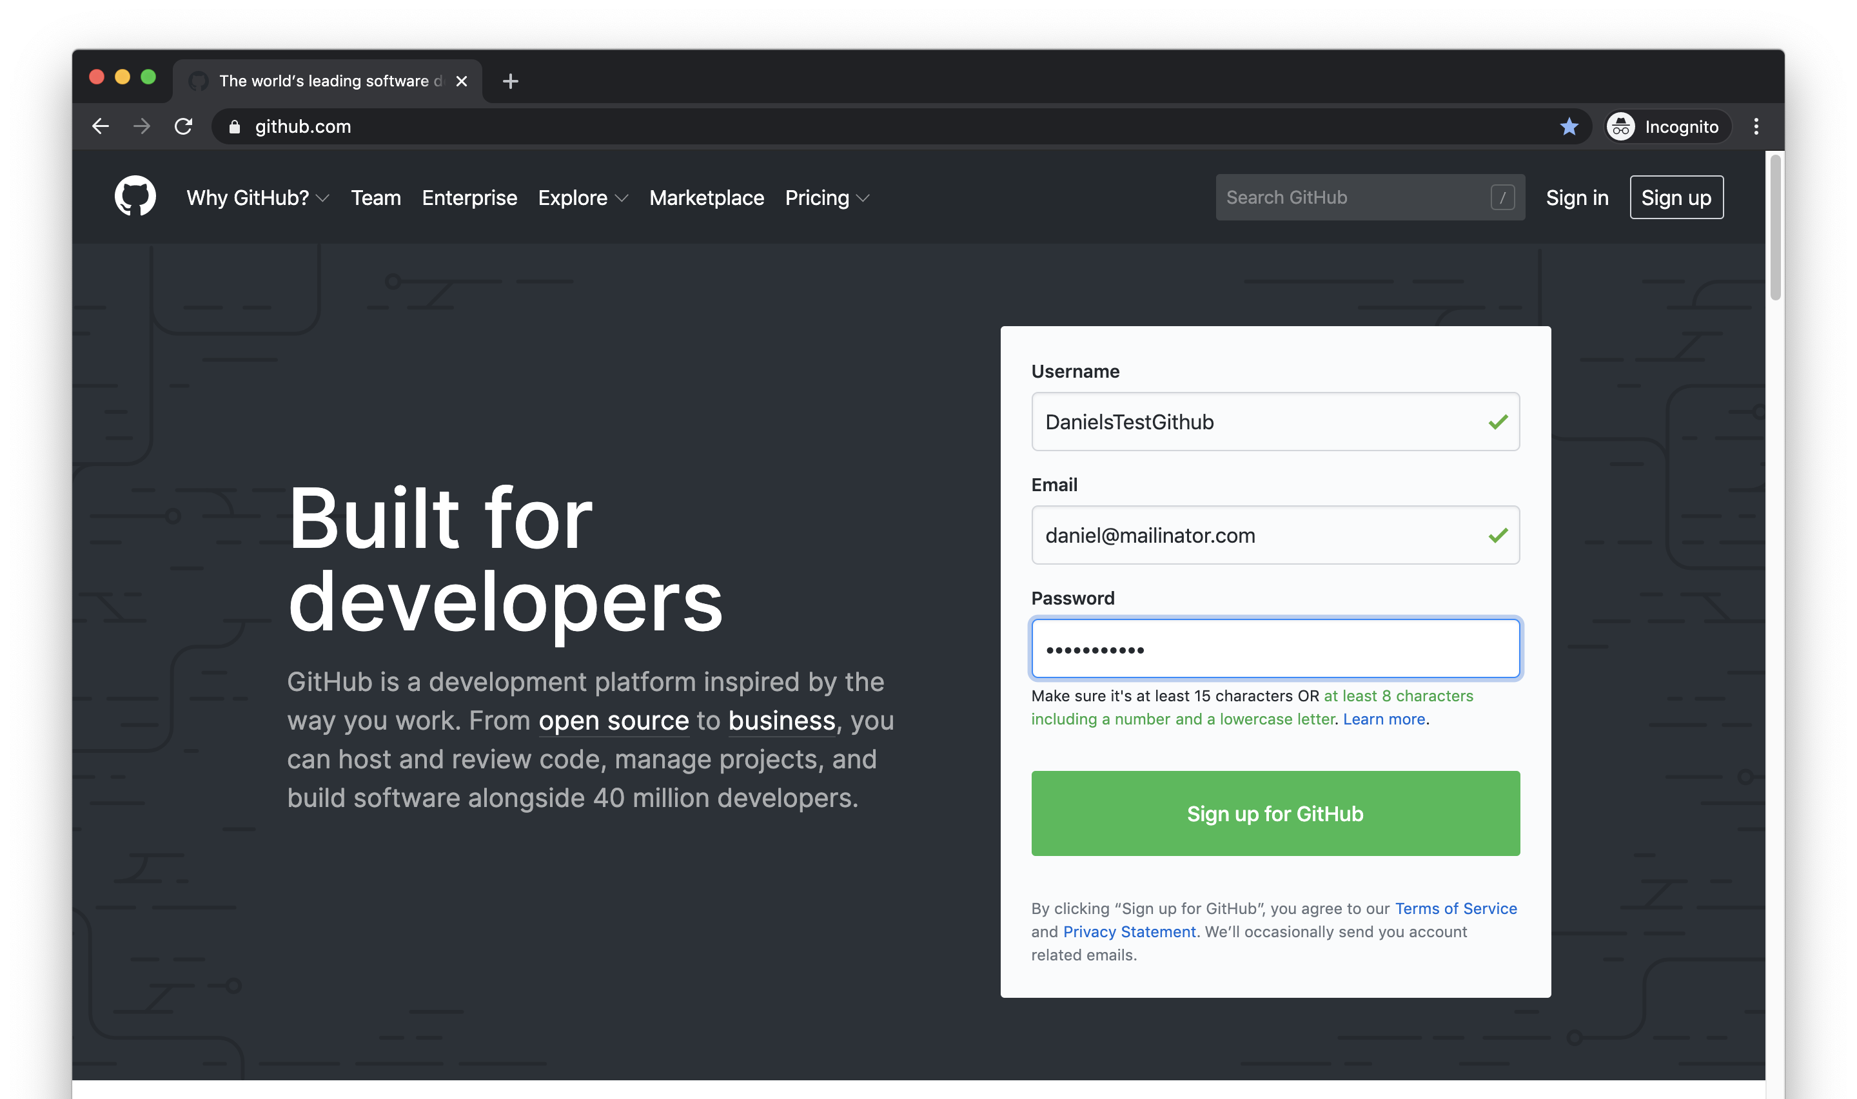

Slide 5
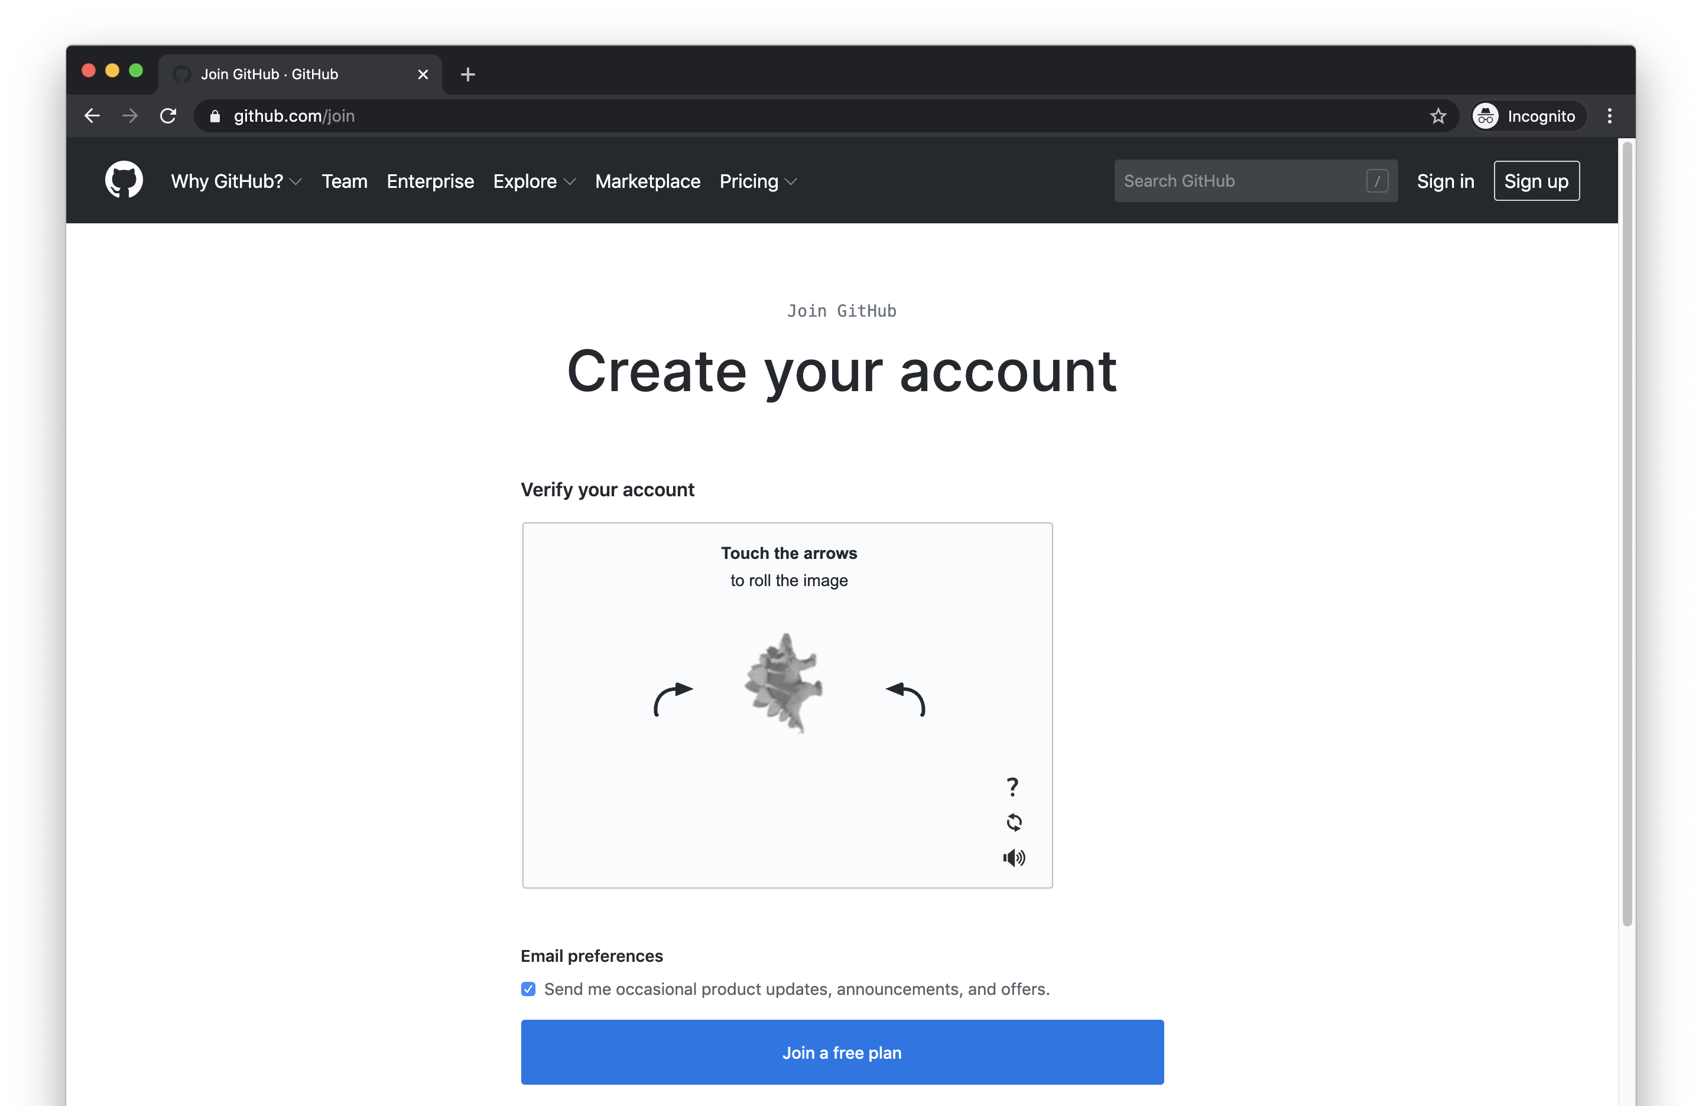

Slide 6
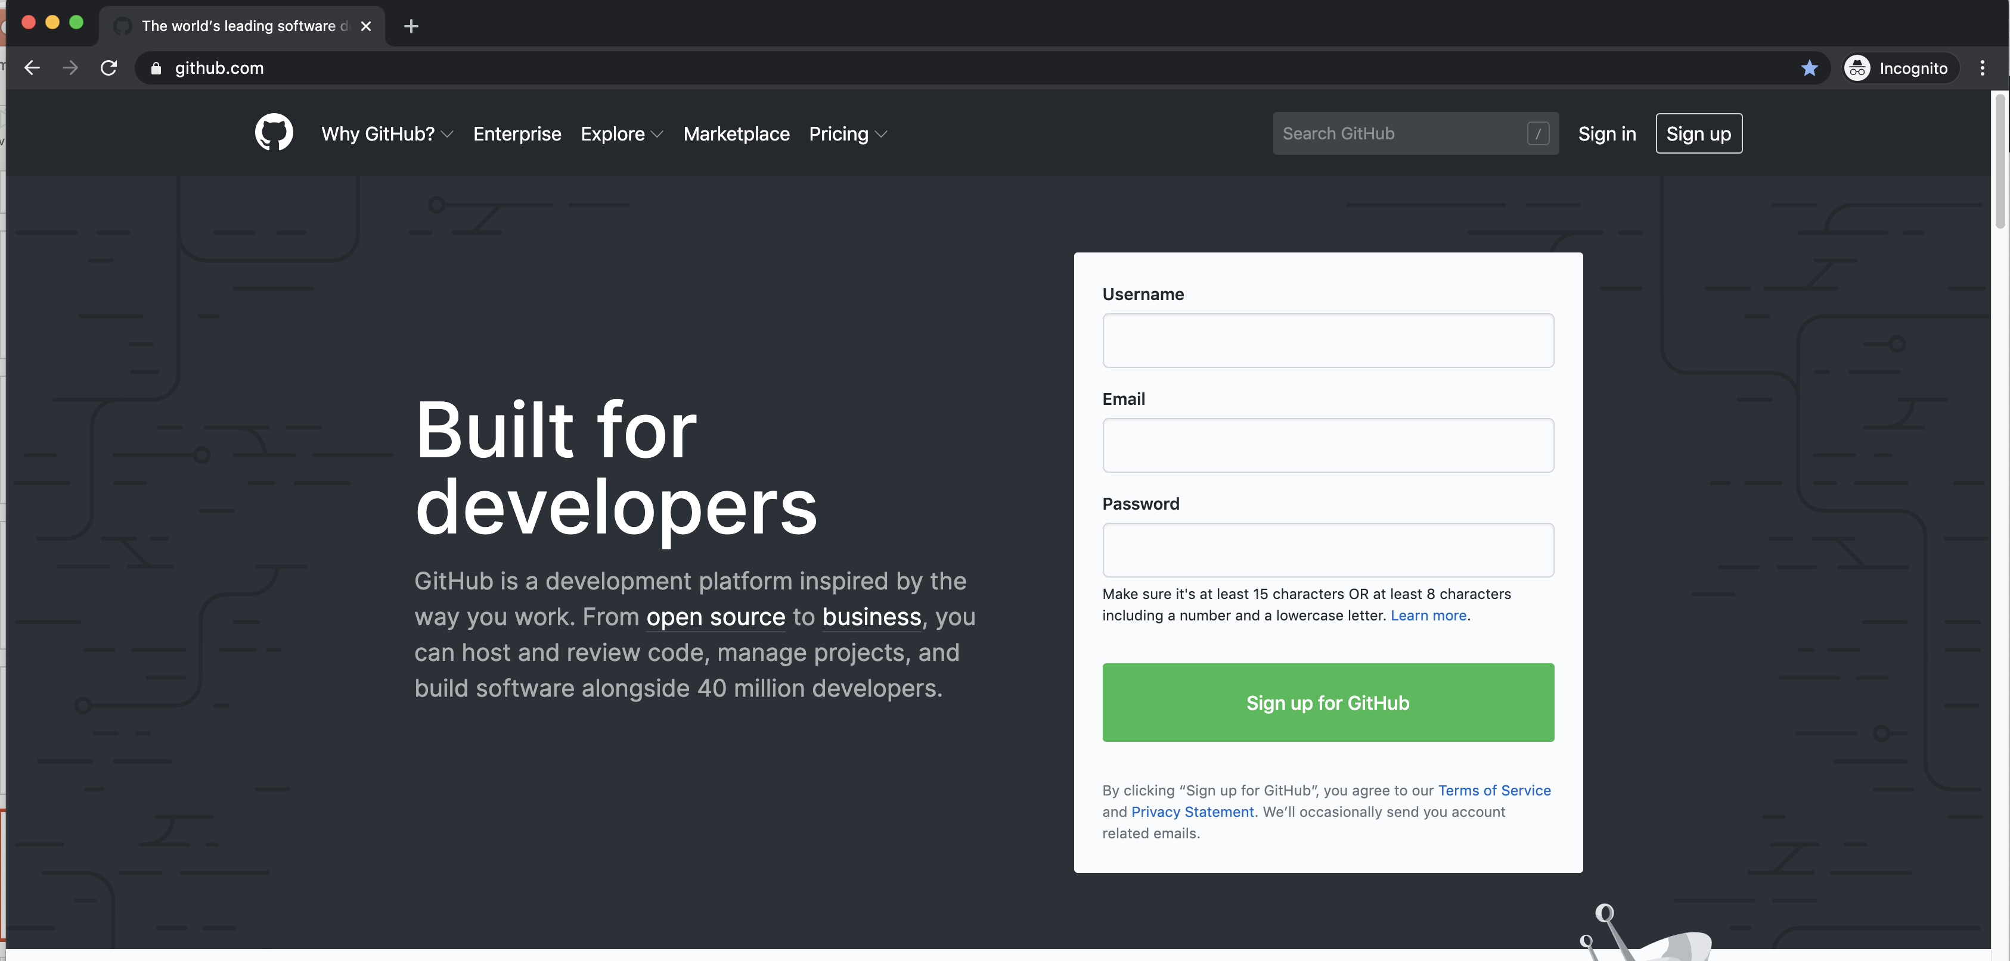

Slide 7
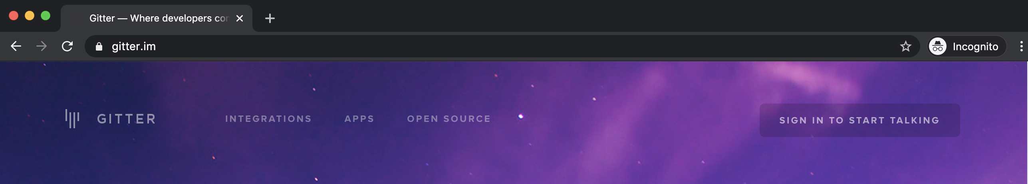
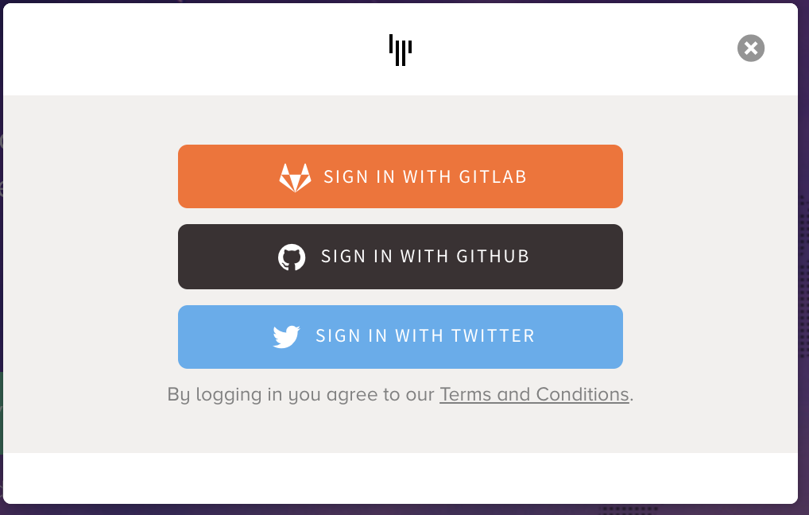
Communicating via Gitter https://gitter.im

Slide 8
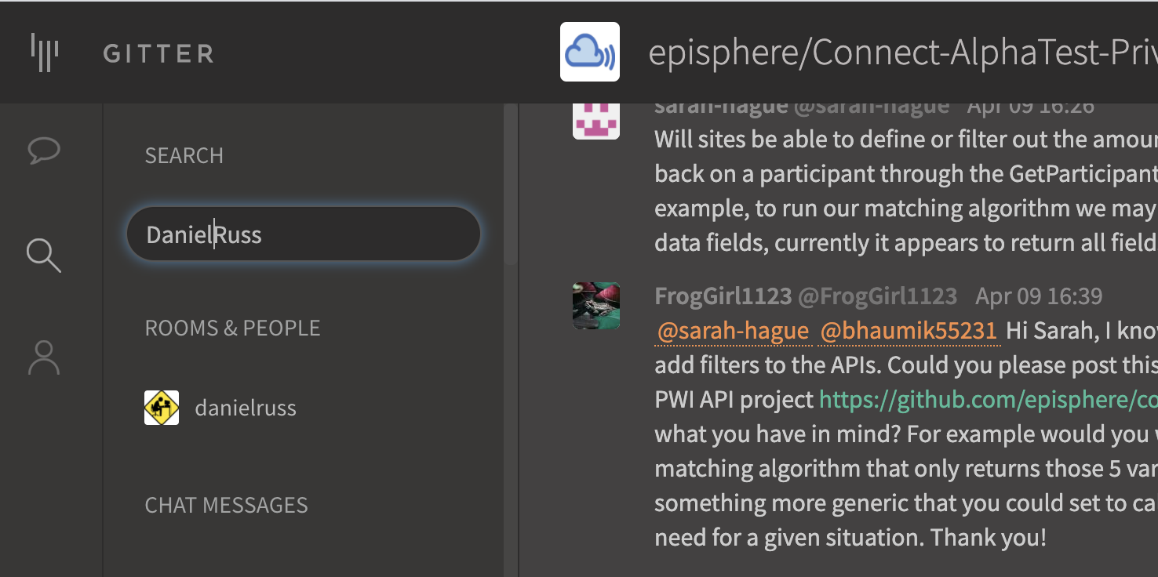
Joining our private gitter chat
https://gitter.im
Contact me: If I know you’re a Connect person, I’ll invite you. I’m in NED or search gitter.
Roster of CONNECT Github Ids
https://nih.app.box.com/file/656624781744
Notes:
Mention that gitter is great for discussion, questions. Bug reports are best handled as issues. Rule of thumb, if you want some kind of action, create an issue. If you have a question or comment, make it in gitter. When in doubt, ask in gitter we may later ask you to create an issue. Suggest that they use gitter to message Mia (miagaudet)

Slide 9
Gitter or Github Issue
Use gitter
Create a github issue
to discuss an issue
to ask a question
to provide feedback when not requested
to report a bug
to request an action
to provide requested feedback
When in doubt, use gitter.
We may ask you to create an issue

Slide 10
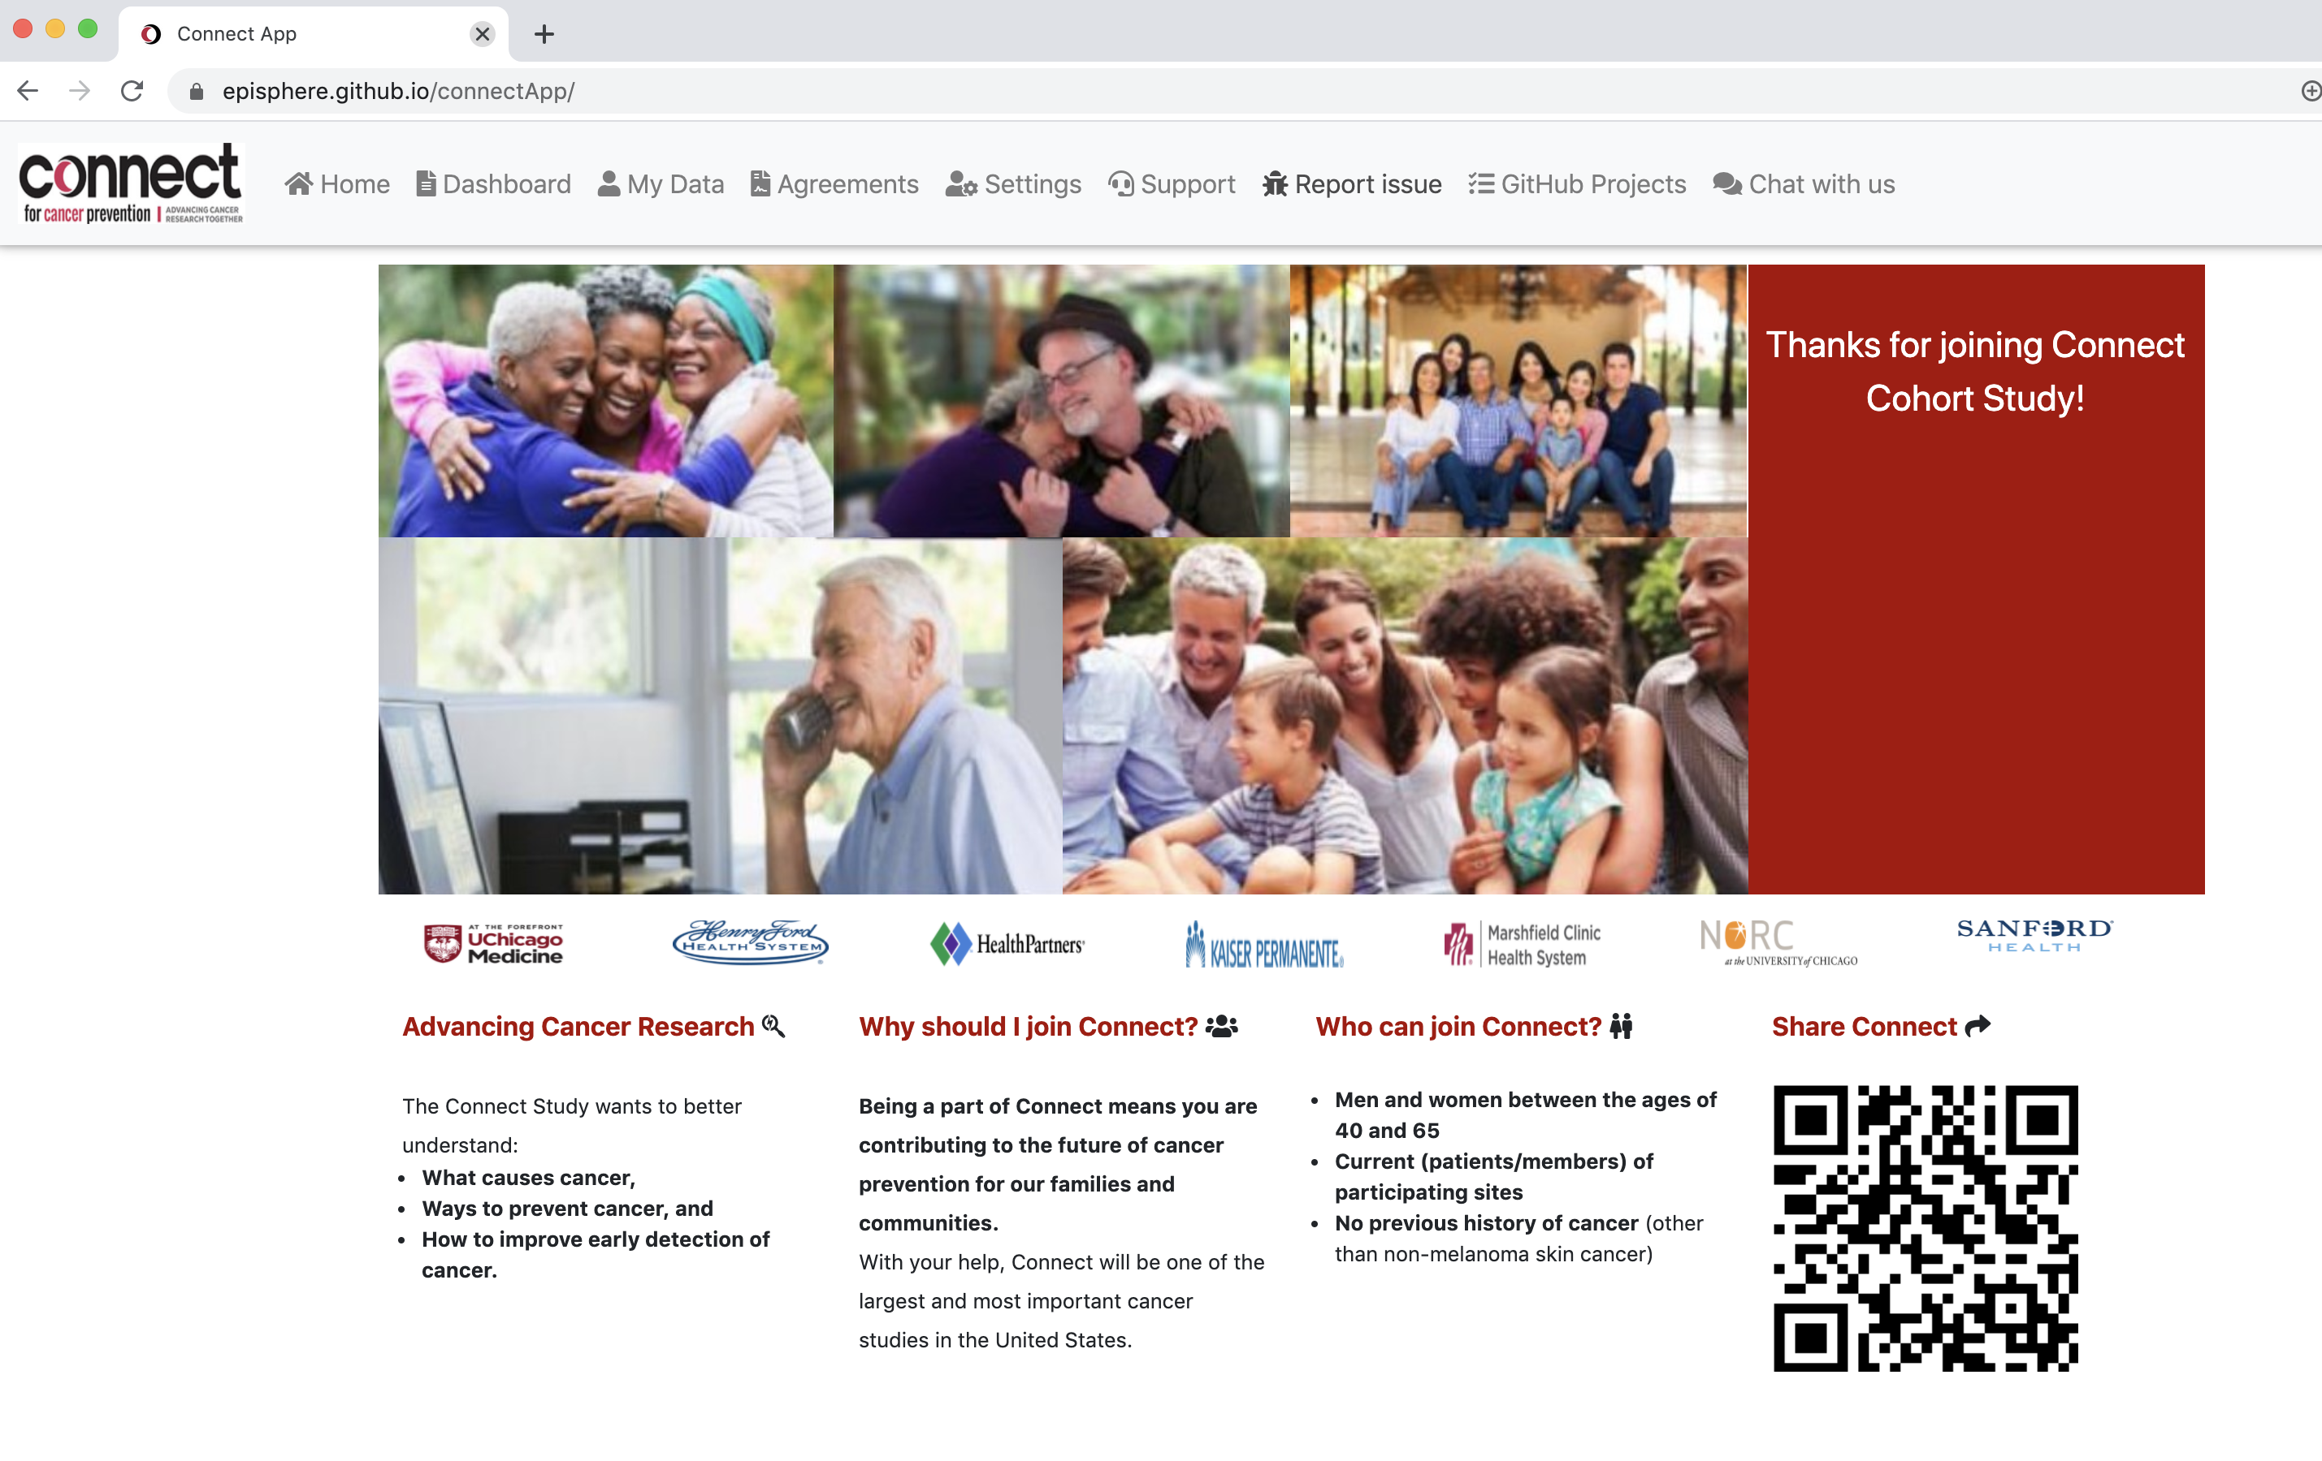
Creating an Issue from the PWA

Slide 11
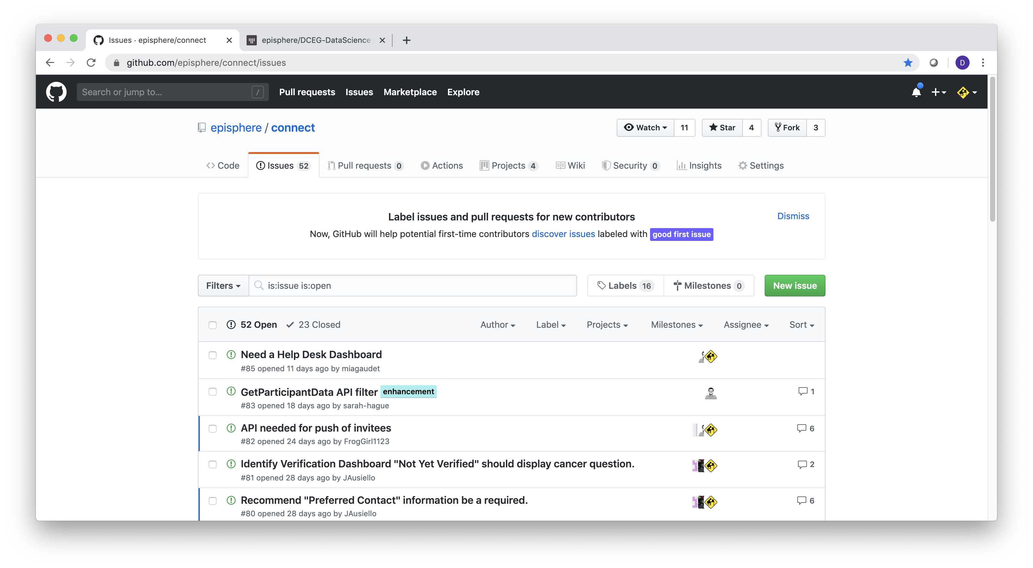
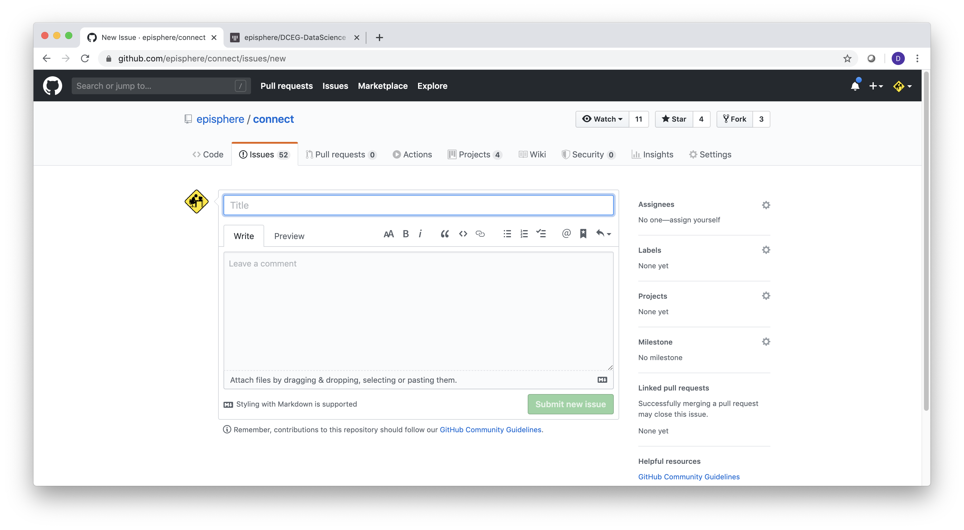
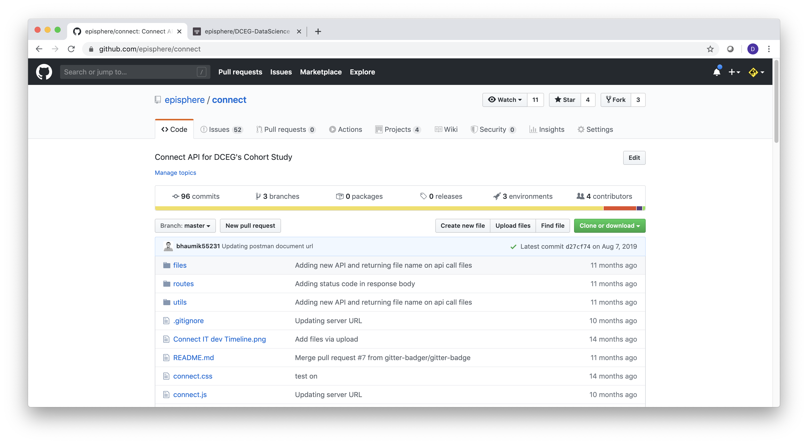
Creating an Issue (Bug report)
Short description of the issue
detailed description of the issue
https://github.com/episphere/connect
Notes:
Mention that you could just go to straight to github directly. After mention the short and detailed description of the problem, point out the assignment/labels on the right but ask them not to touch, a DCEG project manager will triage this.

Slide 12
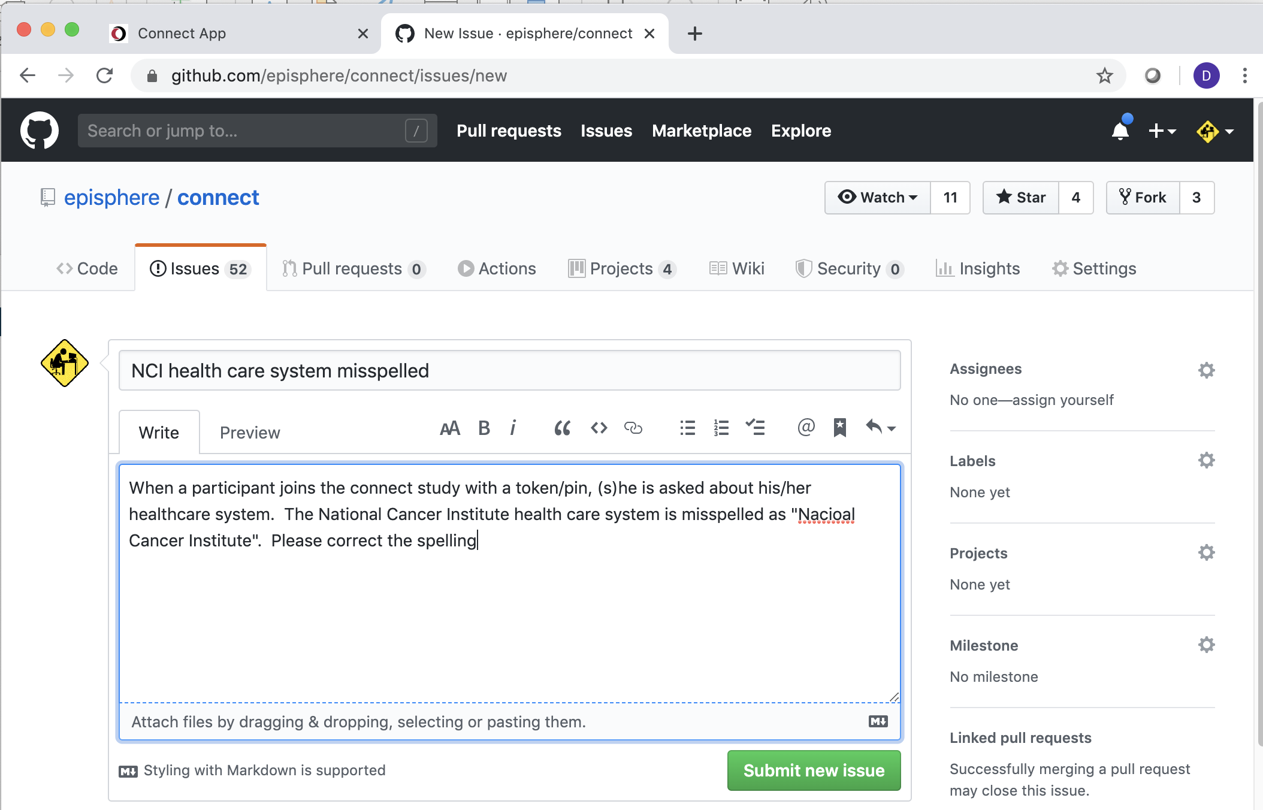
Creating an Example Issue

Slide 13
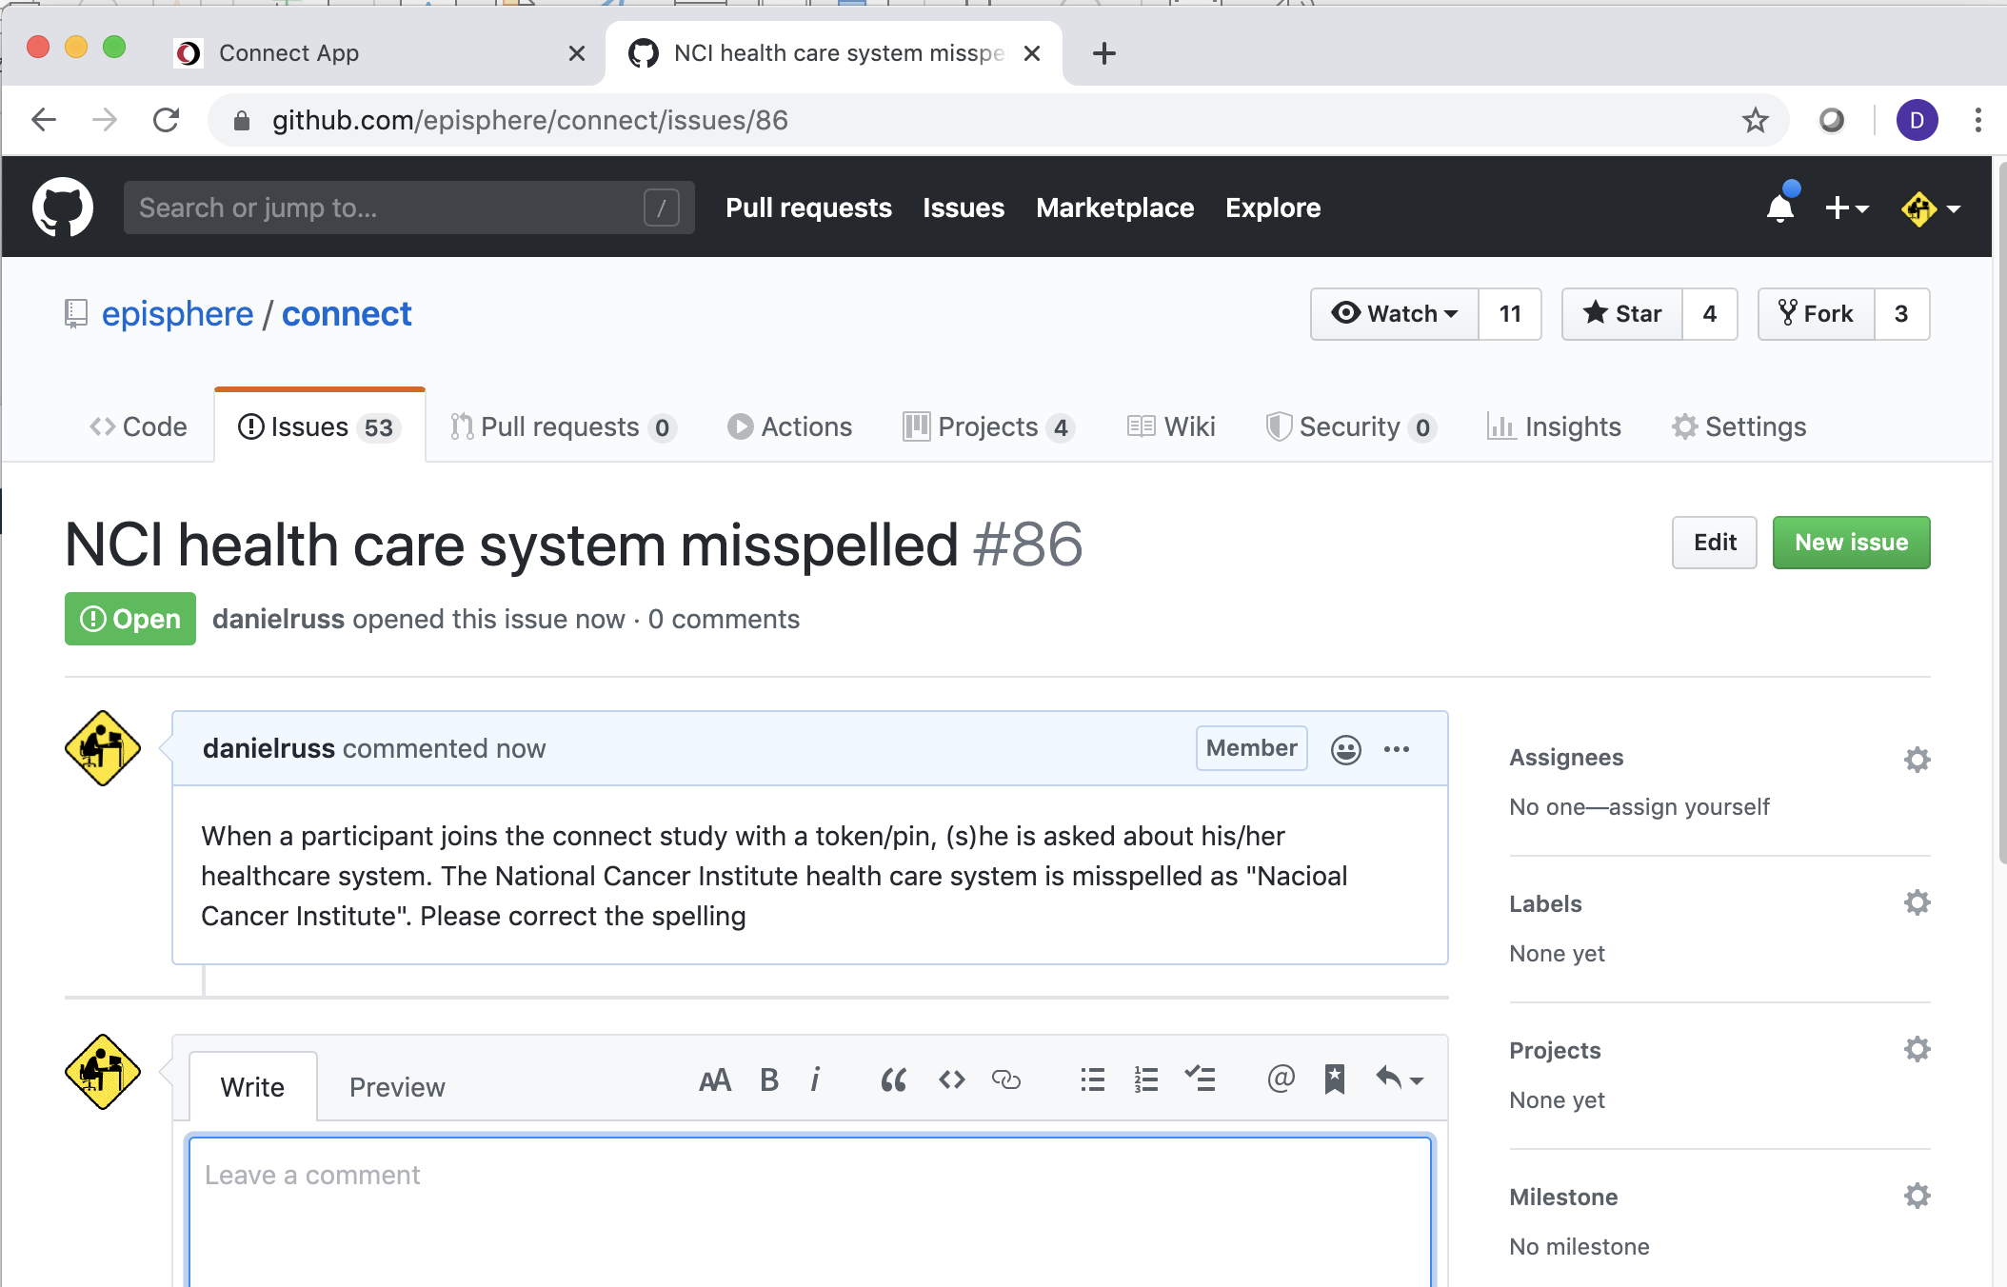
Creating an Example Issue

Slide 14
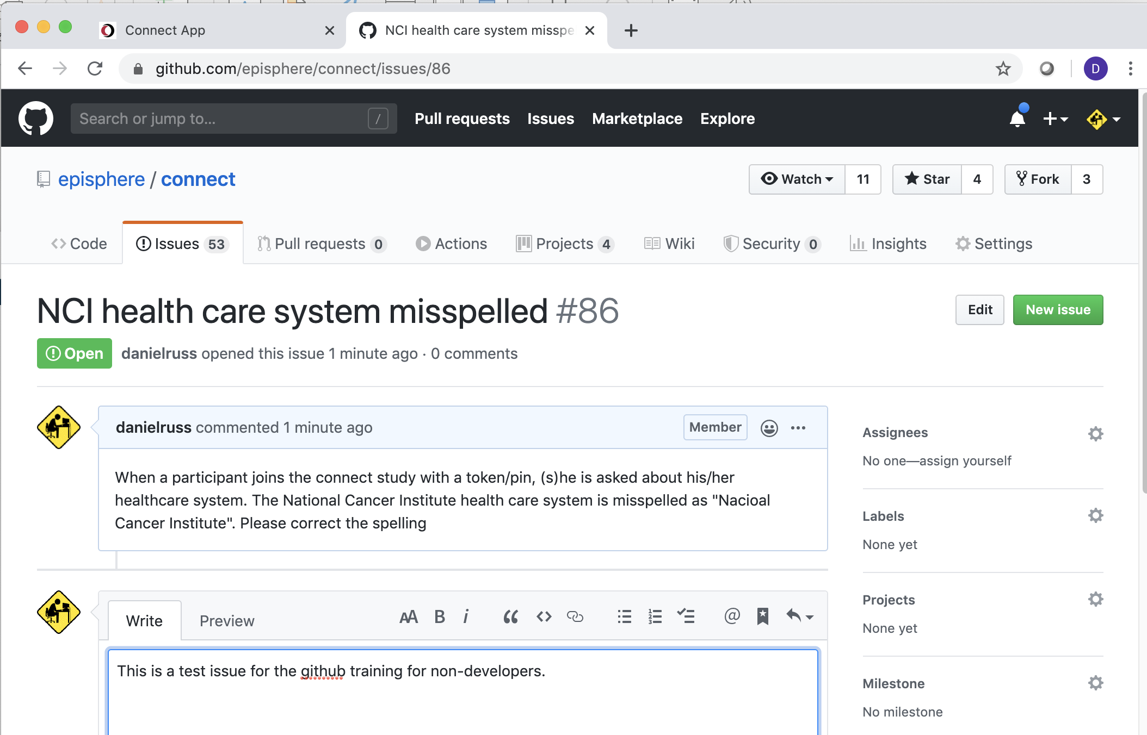
Creating an Example Issue

Slide 15
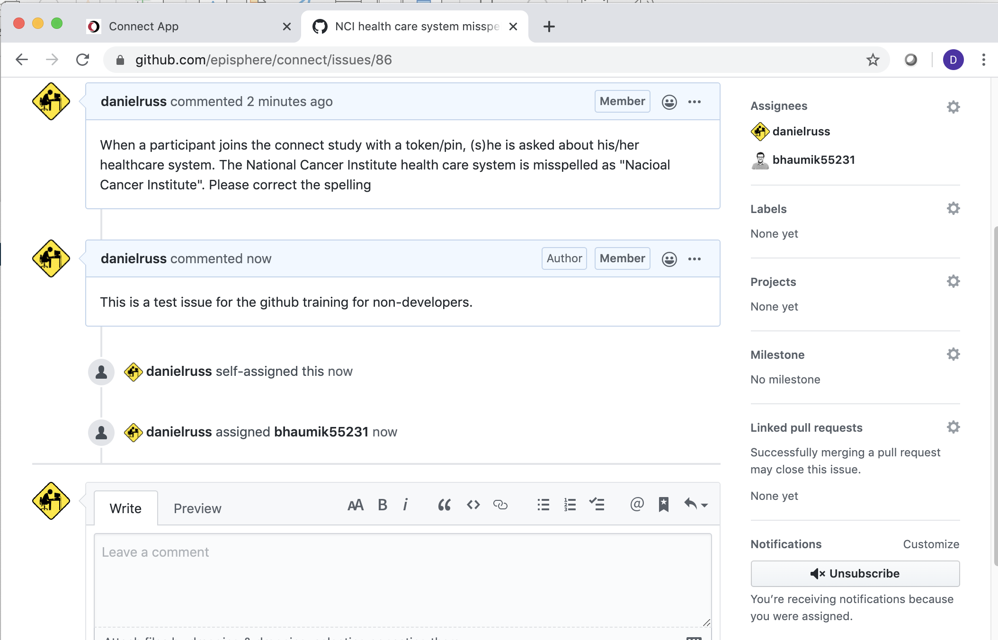
Creating an Example Issue

Slide 16
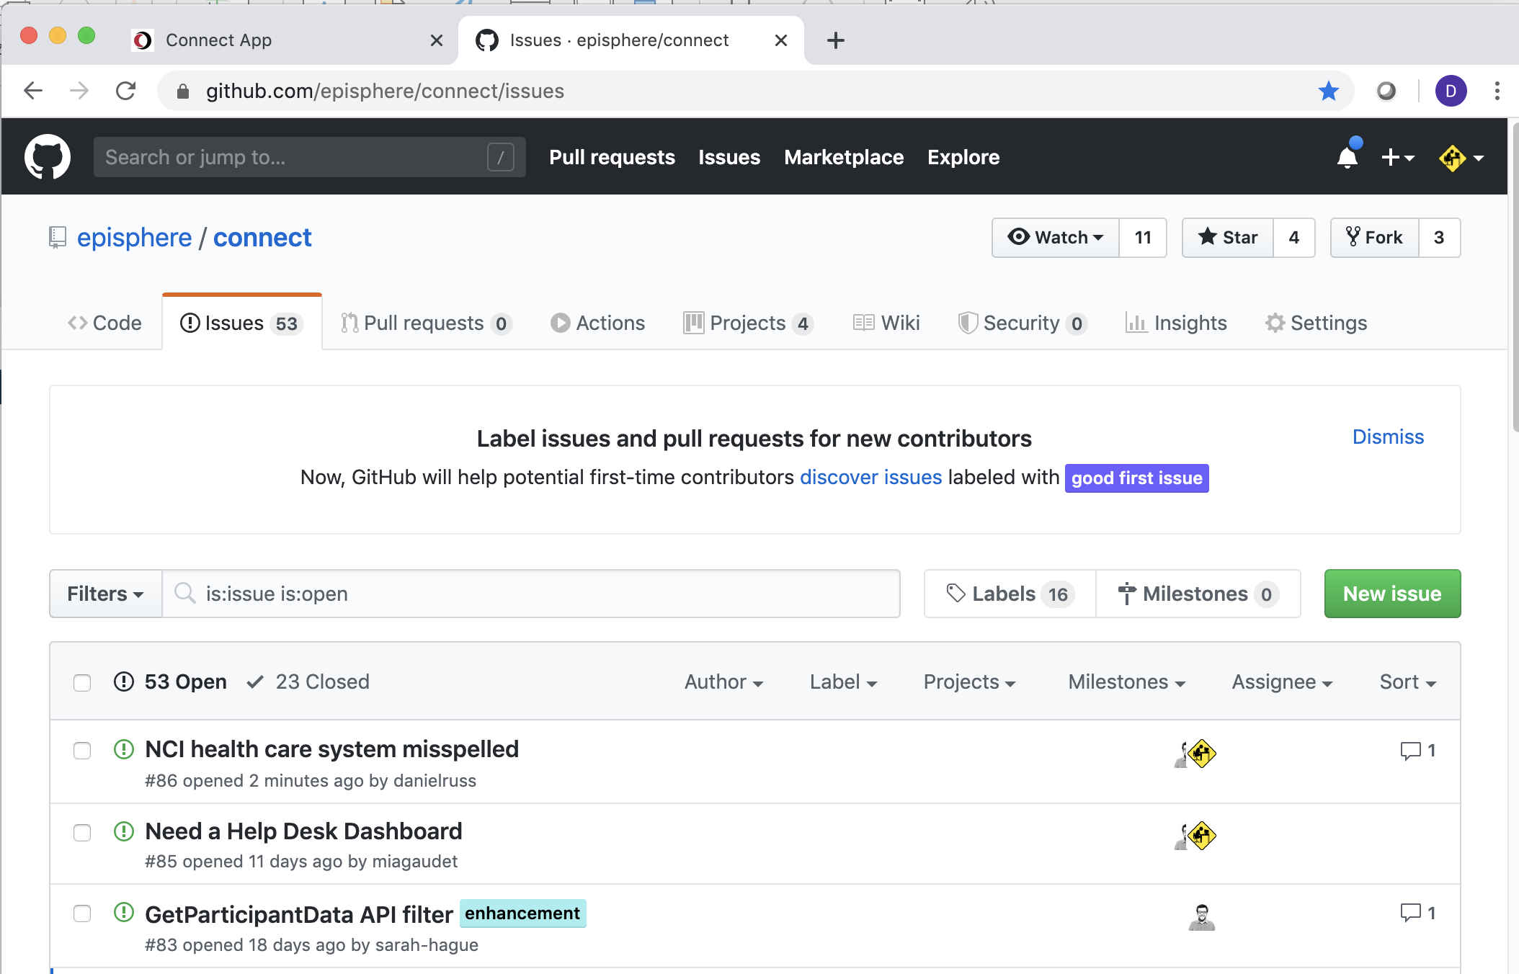
Creating an Example Issue

Slide 17
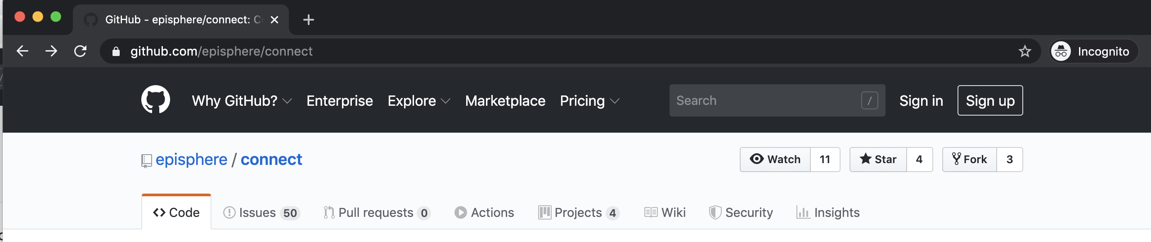
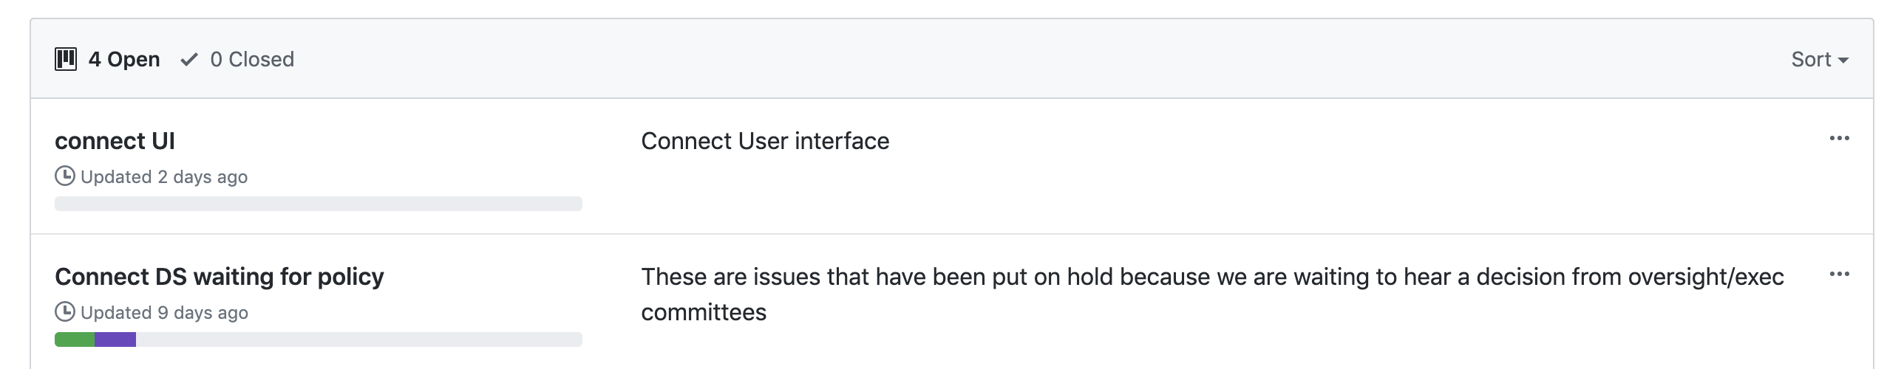
Tracking issues with the Github Kanban

Slide 18
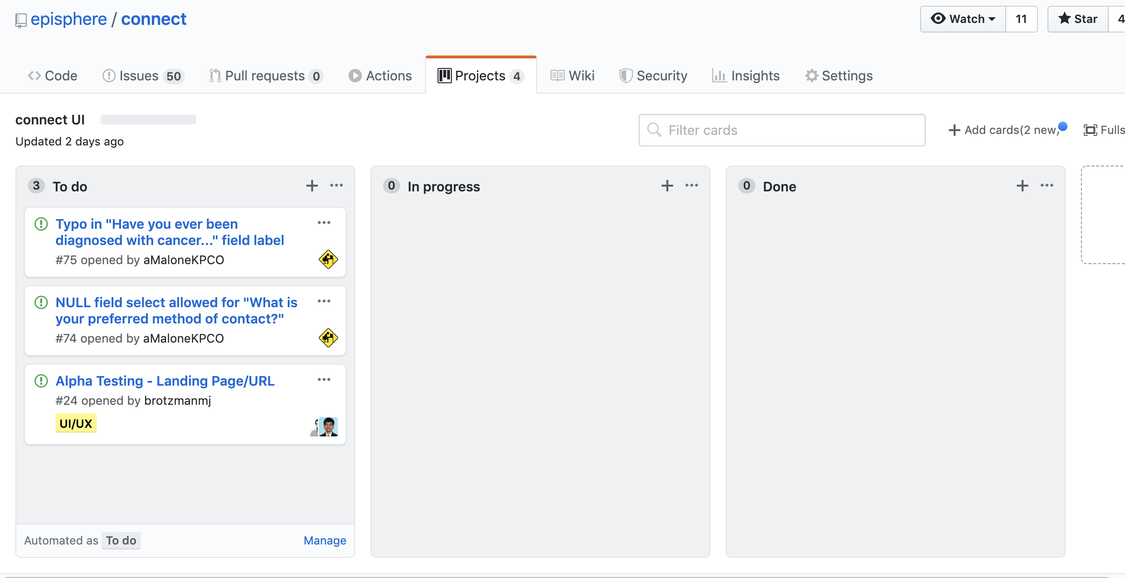
Cards can be dragged into other columns, or set up to do it automatically
Notes:
The Kanban board will be changing to improve communication during the F&R meetings.

Slide 19
Last comments and Questions???
This powerpoint is available in github.
Repository: https://github.com/danielruss/documentation
ppt: https://github.com/danielruss/documentation/GithubIntro.pptx click view raw
Have suggestions or corrections?
Create an issue

